Slide 1



OpenTURNS and HPC with SALOME platform R. Barate EDF R&D
HPC and Uncertainty Treatment
Examples with OpenTURNS and URANIE
EDF – PhiMeca – IMACS -Airbus Group – CEA
Prace Advanced Training Center
May 28th 2015

Slide 2
OUTLINE
OpenTURNS usage in Salome
Presentation of Salome
OpenTURNS integration with Salome platform
Documentation
Using OpenTURNS module graphical interface
Using YACS to call a solver code defined as a Python script
Integration of a code for a usage with OpenTURNS in Salome
Distribution and future evolutions
High Performance Computing (HPC) with OpenTURNS in Salome
HPC-related issues with OpenTURNS
Using Salome for distributed computation with OpenTURNS
Using OpenTURNS module graphical interface: Launch remote computations
Using YACS to call a solver code defined as a Python script: Launch remote computations
Examples of OpenTURNS studies with HPC

Slide 3
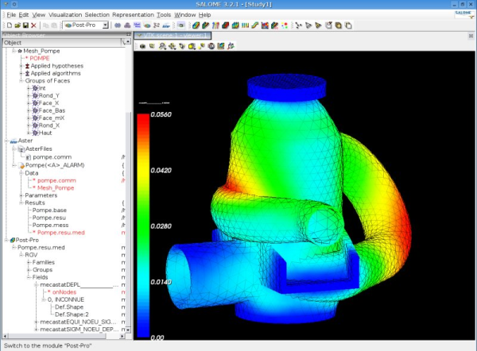
Presentation of Salome
Integration platform for scientific computation codes
Provides modules for geometry modelling, meshing and visualization
Allows the creation and execution of a complete study in a single platform
Allows the standardization and interoperability of computation codes (data exchange model)
Distributed platform (based on CORBA)
Open Source (LGPL)
EDF, CEA and OpenCascade partnership
http://www.salome-platform.org

Slide 4
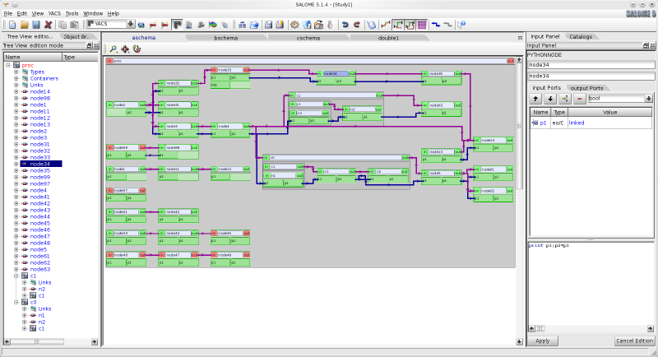
Presentation of Salome (2)
Presentation of YACS
Computation supervision module in Salome
Graphical interface to define chaining or coupling of computation components
Supervisor for the execution of computation schemas
Possibility to run the components on different machines

Slide 5
OpenTURNS integration with Salome platform
Goals
Complete study realized in a single platform
Uncertainty studies on computation schemas (code coupling)
Easier integration with OpenTURNS for the codes already integrated in Salome
Parallelization and distribution of the computations
Possibility to integrate an uncertainty study in a global study with other components
Principles
Integration as a new Salome module
Graphical user interface based on Eficas tool to define a simple OpenTURNS study
Use of the « OptimizerLoop » component of YACS for the computation
Two usage modes
Specific graphical user interface if the solver is already integrated in Salome
YACS graphical user interface to call a solver code as a Python script

Slide 6
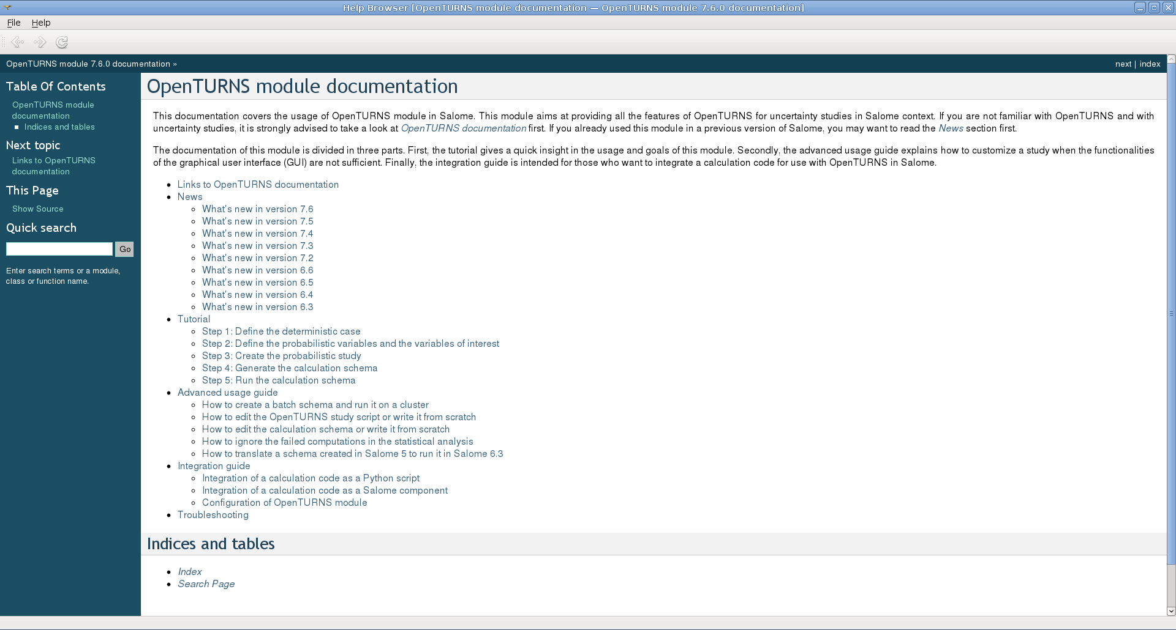
Documentation
OpenTURNS module documentation available from Salome online help (Menu Help / OpenTURNS module / User’s Guide)
Also contains all OpenTURNS documentation

Slide 7

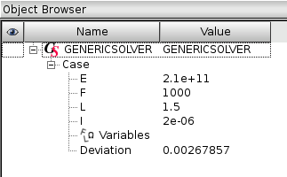
Using OpenTURNS module graphical interface (1/5)
Adapted solution when the solver code is already integrated in Salome
First step: Definition of the « deterministic » study case
Example: Computation of the deviation of a cantilever beam with « GENERICSOLVER » module

Slide 8
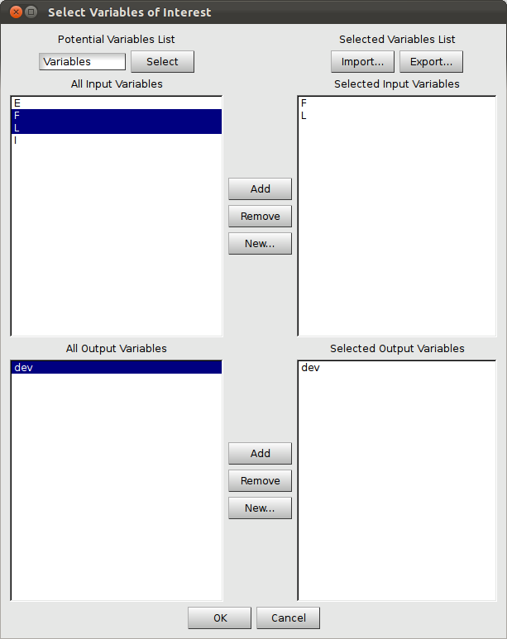
Using OpenTURNS module graphical interface (2/5)
Second step: Definition of the probabilistic variables (solver code input) and the variables of interest (solver code output)

Slide 9
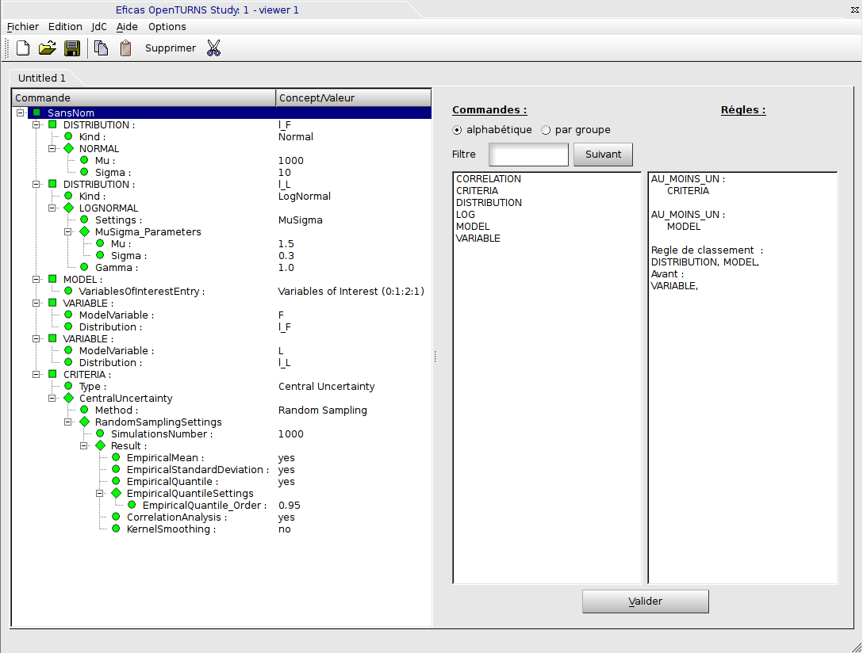
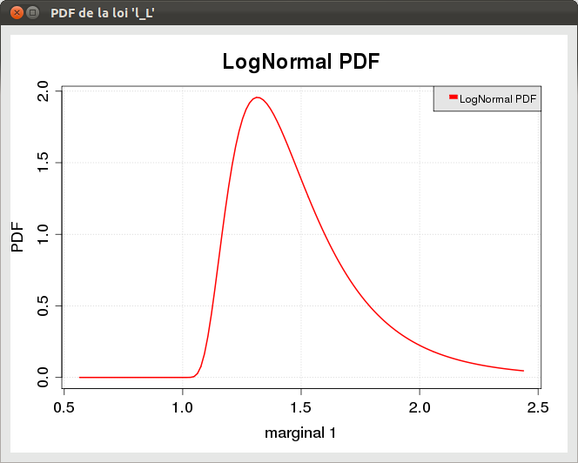
Using OpenTURNS module graphical interface (3/5)
Third step: Definition of the probabilistic study
Graphical interface to define a simple study and to check visually the distributions
For real studies, the generated Python script will generally be completed manually afterward

Slide 10
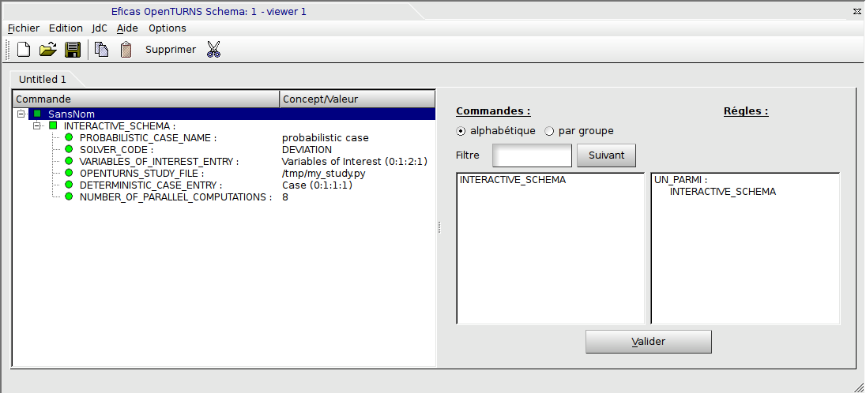
Using OpenTURNS module graphical interface (4/5)
Fourth step: Definition of the execution parameters

Slide 11
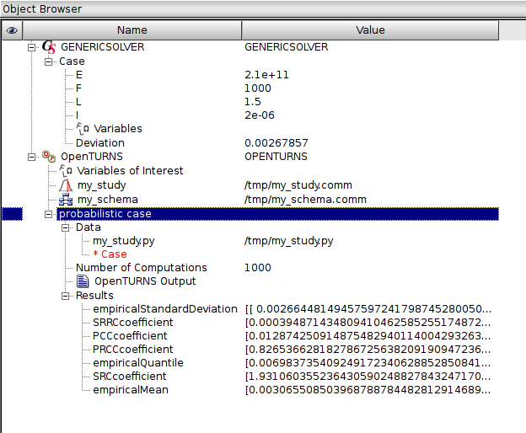
Using OpenTURNS module graphical interface (5/5)
Results

Slide 12
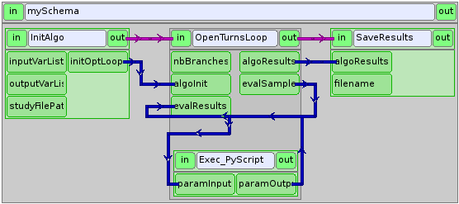
Using YACS to call a solver code defined as a Python script (1/5)
Use of the YACS module to define and run the computation schema
Sample schema for OpenTURNS included in Salome: SALOME_INSTALL_PATH/appli_V7_3_0/share/salome/openturns_samples/schema_pyscript.xml

Slide 13
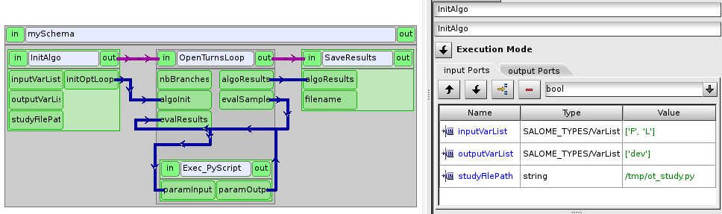
Using YACS to call a solver code defined as a Python script (2/5)
Initialization node
List of input variables
List of output variables
OpenTURNS script to run

Slide 14
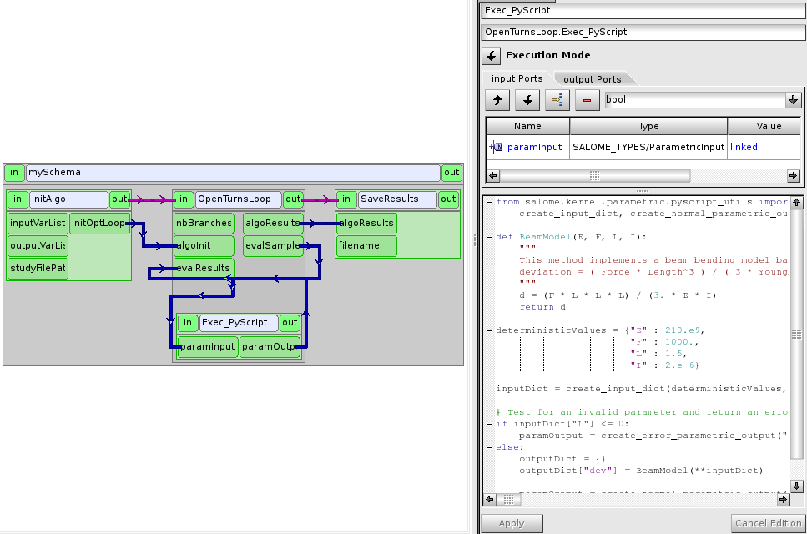
Using YACS to call a solver code defined as a Python script (3/5)
Execution node
Solver code defined as a Python script
Can parse and replace values in files (openturns.coupling_tools)
Can call an external command: os.system()

Slide 15
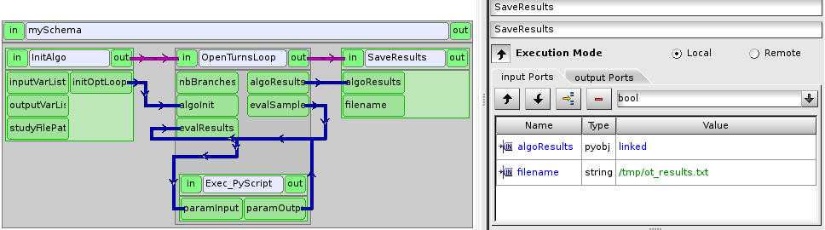
Using YACS to call a solver code defined as a Python script (4/5)
Node used to save or post-process the results
File where the results are saved

Slide 16

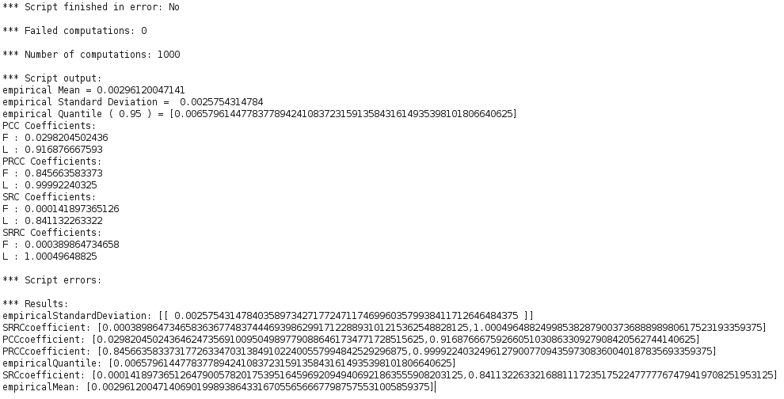
Using YACS to call a solver code defined as a Python script (5/5)
Activate execution mode for the schema:
Run the schema:
Results:

Slide 17
Integration of a code for use with OpenTURNS in Salome
Creation of a Salome component instead of an OpenTURNS wrapper
Implementation of the component in C++ or Python
Main requirements
Ability to perform parametric computations
Ability to publish a study case in Salome study tree
Salome provides a tool (YACSGEN) to facilitate the creation of Salome components
See the example script SALOME_INSTALL_PATH/appli_V7_6_0/share/salome/resources/genericsolver/yacsgen_example.py
See OpenTURNS module documentation, section « Integration Guide »
Also see YACS module documentation

Slide 18
Distribution and future evolutions
Distribution of SALOME + OpenTURNS platform
OpenTURNS integrated with YACS since SALOME 5.1.5 (December 2010)
LGPL license for the whole platform (SALOME + OpenTURNS + OPENTURNS module)
SALOME platform with OpenTURNS is not distributed yet on http://www.salome-platform.org
But it is distributed through Salome-Meca (http://www.code-aster.org/astersalome)
Improvements to come
Better execution follow-up
Enable the distribution of MPI parallel codes
Fault tolerance, resume after crash
Better integration with batch managers
Job sizing depending on cluster workload
Dynamic adaptation depending on cluster workload
Integration with Paravis for more visualization possibilities
Graphics (Boxplot, etc.)
Visualization of fields with uncertainties

Slide 19
OUTLINE
OpenTURNS usage in Salome
Presentation of Salome
OpenTURNS integration with Salome platform
Documentation
Using OpenTURNS module graphical interface
Using YACS to call a solver code defined as a Python script
Integration of a code for a usage with OpenTURNS in Salome
Distribution and future evolutions
High Performance Computing (HPC) with OpenTURNS in Salome
HPC-related issues with OpenTURNS
Using Salome for distributed computation with OpenTURNS
Using OpenTURNS module graphical interface: Launch remote computations
Using YACS to call a solver code defined as a Python script: Launch remote computations
Examples of OpenTURNS studies with HPC

Slide 20
HPC-related issues with OpenTURNS
OpenTURNS is a « perfect » target for High Performance Computing (HPC)
In general, execution of a large number of independent computations (algorithms like Monte Carlo)
« Black box » interface with the computation code
Computation time of OpenTURNS algorithms generally very small compared to the calls to the solver code
Multi-threaded algorithms (in shared memory)
Distributed calls to the solver code
But…

Slide 21
HPC-related issues with OpenTURNS (2)
OpenTURNS is supposed to deal with all the hardware / software combinations
The usage of distributed resources is very dependent on the context:
Use of a cluster (homogeneous, centralized) / a grid (heterogeneous, decentralized)?
Communication protocol with the cluster?
Which batch / grid manager?
Can we install softwares on the cluster?
Global / local (by node) filesystem?
Execution of OpenTURNS script on the client workstation / on the cluster?
Which middleware for the distribution on the cluster?
Size of input and output files of the solver code?
No unique solution adapted to all contexts

Slide 22
Using Salome for distributed computation with OpenTURNS
Take advantage of Salome features
Computation distribution (YACS supervisor)
Launch and monitor remote computations, typically on clusters (JobManager module)
Manage the communication with the cluster (SSH or RSH)
Manage the file transfer
Submission and monitoring of jobs
Abstraction of the batch managers (LSF, PBS, Slurm, SGE, LoadLeveler, OAR)
Possibility to use different protocols between the nodes (SSH, srun, pbsdsh, …)
Technical choices
Execution of the schema on the cluster as a unique job
Requires the installation on the cluster of Salome platform including OpenTURNS

Slide 23
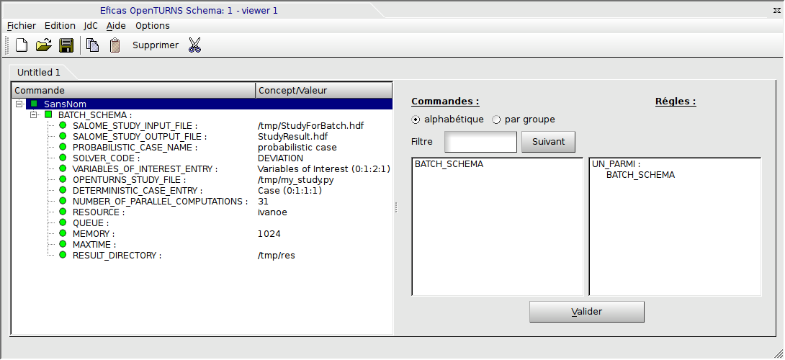
Using OpenTURNS module graphical interface: Launch remote computations (1/2)
Define the execution parameters

Slide 24

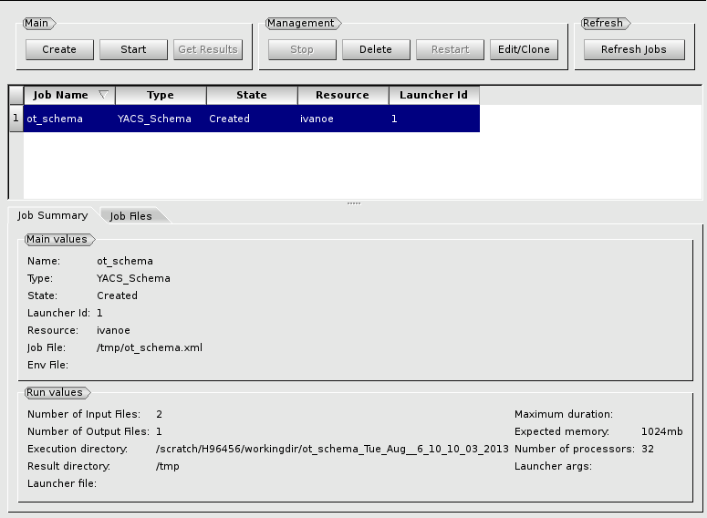
Using OpenTURNS module graphical interface: Launch remote computations (2/2)
Launch job with JobManager module

Slide 25
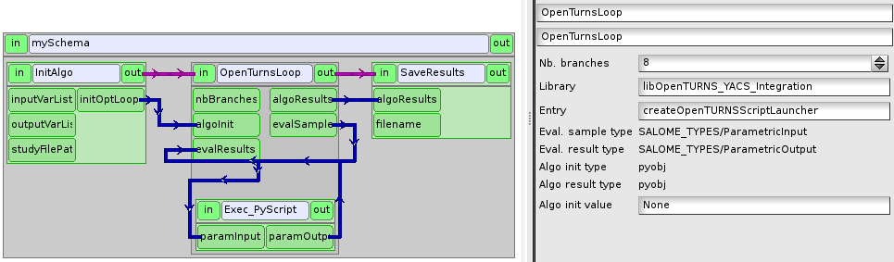
Using YACS to call a solver code defined as a Python script: Launch remote computations (1/3)
Number of parallel computations
Number of parallel computation branches

Slide 26
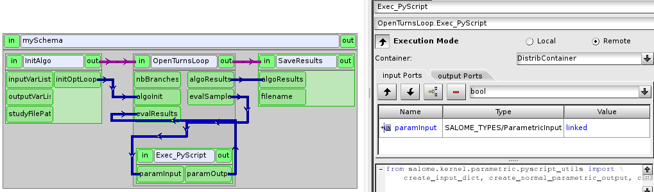
Using YACS to call a solver code defined as a Python script: Launch remote computations (2/3)
Computation node execution mode
Execution mode: « Remote »
Execution container: « DistribContainer »

Slide 27
Using YACS to call a solver code defined as a Python script: Launch remote computations (3/3)
Creation of a new job and launch from JobManager module

Slide 28
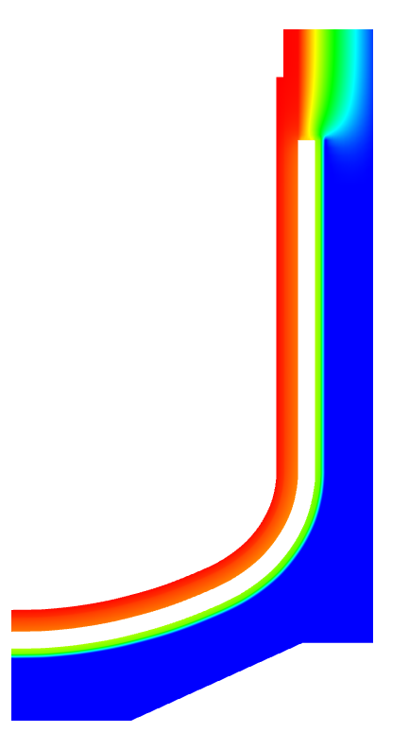
Examples of OpenTURNS studies with HPC
Thermal evacuation of residual power
Uncertainty computation and variable ranking (with 4 uncertain parameters) on the thermal evacuation of residual power through the reactor well in a Gen IV sodium-cooled fast reactor
Solver: SYRTHES (code for thermal conduction / radiation)
Elementary calculation: Mesh with 10500 elements. Convergence reached in about 20 seconds on a workstation (one processor only, the elementary case being small)
OpenTURNS study: 5000 to 10000 elementary calculations ➔ about 50 CPU hours
Temperature field

Slide 29
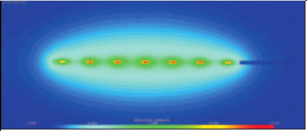
Examples of OpenTURNS studies with HPC (2)
HA/LL waste storage
Uncertainty propagation for the calculation of thermal sizing for the storage of high activity and long life nuclear waste
Solver: SYRTHES
Elementary calculation: 10 minutes on 8 cores on a workstation (parallelization in shared memory)
OpenTURNS calculation: 6000 elementary calculations ➔ about 8000 CPU hours (jobs of 512 elementary calculations on 32 nodes)
Temperature field after several years in geological storage

Slide 30
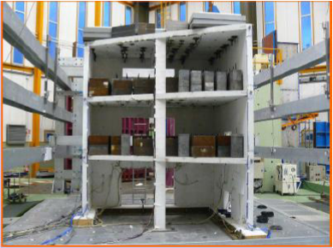
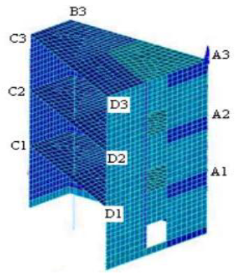
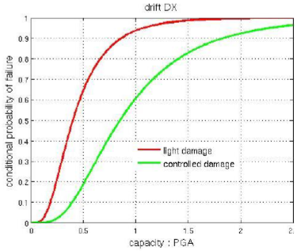
Examples of OpenTURNS studies with HPC (3)
Seismic resistance with Salome-Meca: SMART Benchmark
Fragility curves in the framework of the SMART 2008 benchmark (CEA-EDF)
FE solver: Code_Aster (structural mechanics)
Variable of interest: Drift between two levels
Two damage categories (3mm and 6mm)
Uncertainty modelling
50 accelerograms
3 uncertain model parameters
Concrete model used in
SMART benchmark
Mesh used by
Code_Aster
Fragility curves

Slide 31
Examples of OpenTURNS studies with HPC (4)
Seismic resistance with Salome-Meca: Real application
2012: Reuse of the methodology defined in SMART benchmark for a real industrial structure
Elementary dynamic computation: 50 to 200h on a workstation
OpenTURNS study: 186 elementary computations with different parameters and accelerograms
Computations distributed on 35 CPUs for a total of 425h (~ 18 days) ➔ ~ 15000 CPU hours

Slide 32
Questions?

